Slide 1






Lecture 30:
useRef Hook
Course - Web Development - II
-By
Instructor Name
welcome@krmangalam.edu.in
Sohna Road,Gurugram,Haryana 122103

Slide 2

| Table of Contents
useRef for Direct DOM Manipulation.
References.
The End.

Slide 3
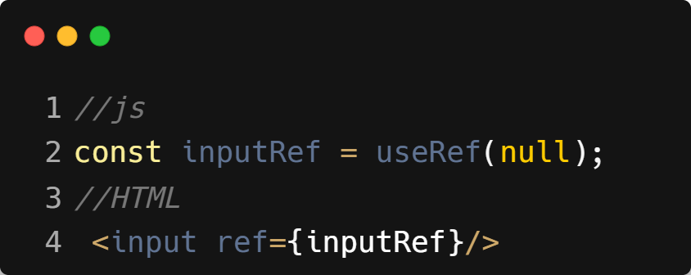
| useRef
useRef is a React Hook that gives you a way to directly access and interact with DOM elements or store mutable values that do not trigger a re-render when changed.
Key Uses
Access DOM elements directly (like document.getElementById, but React-friendly).
Store values across renders without causing a component to update.
Keep mutable variables (e.g., timers, counters) without affecting UI.
Syntax :

Slide 4
| useRef : Working
useRef(initialValue) returns an object: { current: initialValue }.
The current property can be:
A DOM element reference.
Any mutable value you want to keep between renders.
Changing current does not cause re-render.

Slide 5
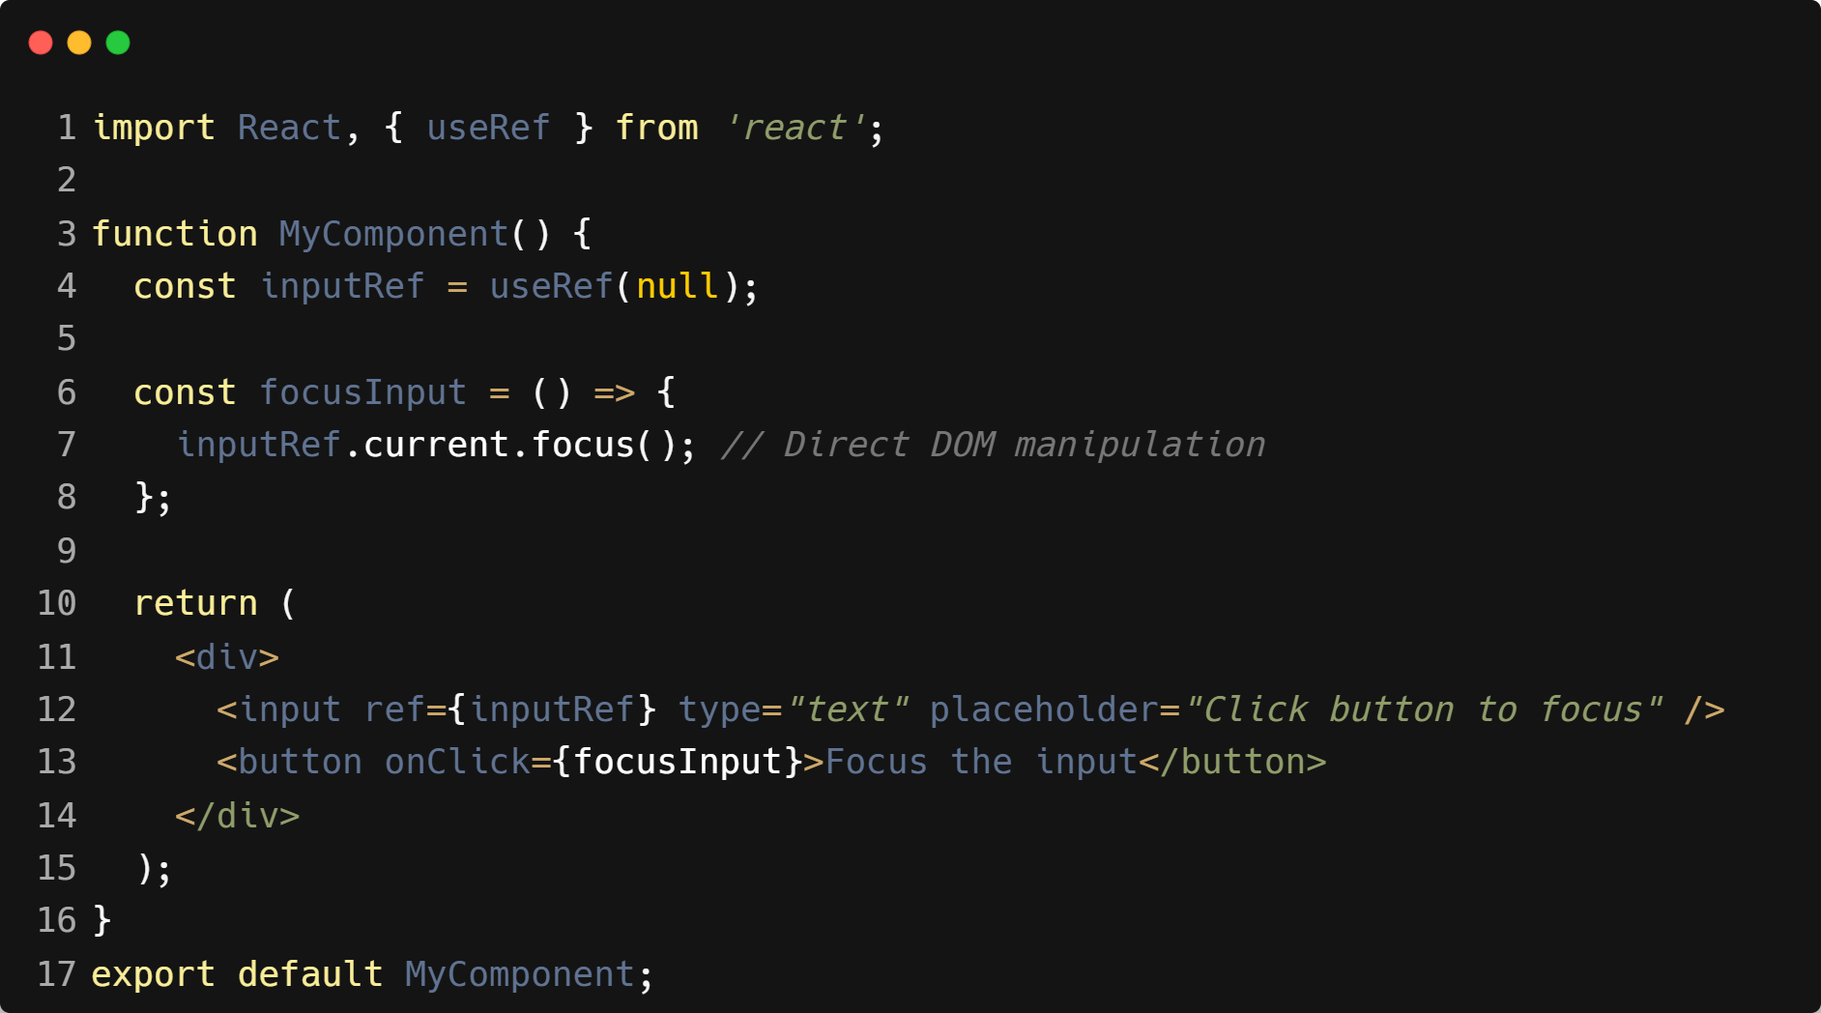
| Example : useRef

Slide 6
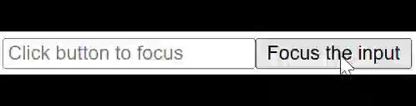
| Output : useRef

Slide 7

| Check Your Understanding
Question : What is the main purpose of the useRef Hook in the context of forms?
Options : a) To manage the component's state.
b) To create a reference to a DOM element, often used to get the value from an uncontrolled
component.
c) To prevent the component from re-rendering.
d) To validate the form's input.
Answer : b) To create a reference to a DOM element, often used to get the value
from an uncontrolled component.
Explanation:
useRef allows you to create a direct link to a DOM node, bypassing the typical state-driven flow. For uncontrolled forms, it's the primary way to "pull" the value from the DOM when you need it (e.g., on submission).

Slide 8
| References
MDN Web Docs : Comprehensive and official documentation for JS. 🔗https://developer.mozilla.org/en-US/docs/Web/JavaScript
W3Schools – JS Tutorial : Beginner-friendly JS tutorials with examples and interactive editors. 🔗 https://www.w3schools.com/js/
react.dev - A comprehensive, tutorial-style website that deeply explores core React concepts, including components, state, effects, and hooks, through interactive examples and in-depth explanations.
🔗https://react.dev/

Slide 9
Thanks
For
Watching
Course - Web Development - II
welcome@krmangalam.edu.in
Sohna Road,Gurugram,Haryana 122103

